Slide 1
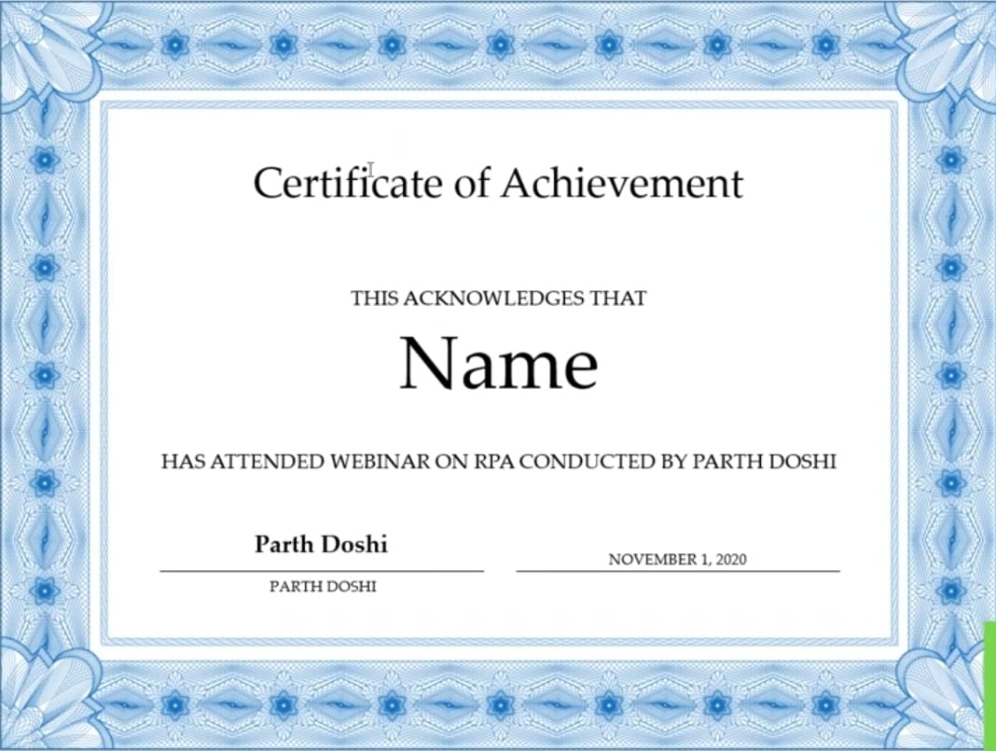
Certificate of Participation
THIS ACKNOWLEDGES THAT
Deepa C shet
HAS PARTICIPATED IN Hackthon CONDUCTED BY
A.G.M RURAL COLLEGE | BRANCH: CSE
MRS. KAVITHA
SEPTEMBER 28,2026

